Slide 1

WEB Course
Design
Build
Launch
WEB DEVELOPMENT FOR BEGINNERS
Instructor
Duration
Manel Fabillar
SY2024 - 1st Semester

Slide 2

Table of Contents
World Wide Web Fundamentals and History
Introduction to HTML5 & CSS 3.0
Basic HTML5 Structure
Styling with CSS 3.0
Responsive Web Design
Best Practices & Advance Techniques
Practical Project

Slide 3


Who?
Manel Cabiluna-Fabillar
Senior Front-end Developer, Shopify Developer, QA and Lead Developer
GOAL
Empowering you with the essential skills and confidence to design and build professional, responsive websites from scratch. Enabling you to turn your ideas into fully functional web pages by the end of the course.

Slide 4
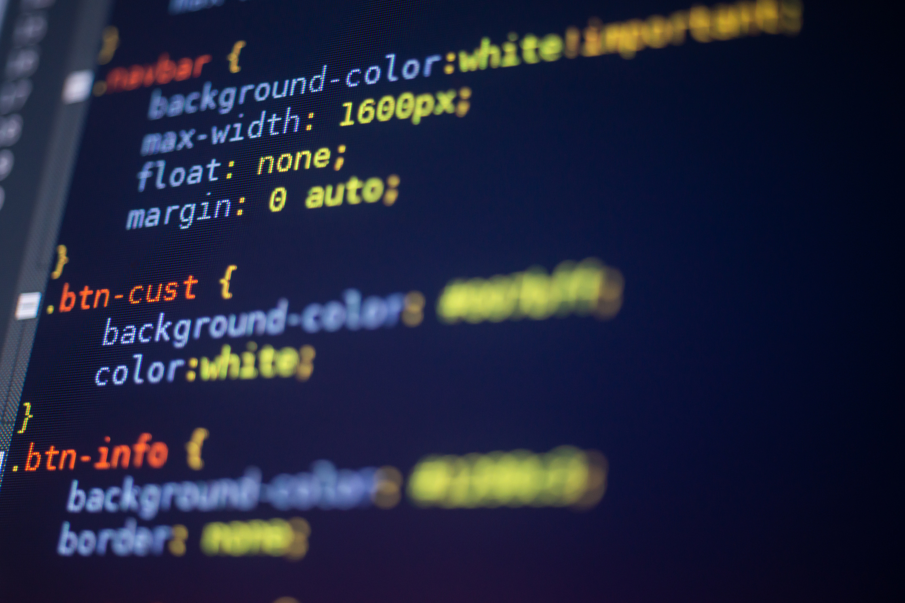

Understanding Web Communication

Slide 5
OBJECTIVE OF THIS MODULE
“To understand the basic principles of how communication happens over the web and the technologies that enable it.”

Slide 6

World Wide Web
Definition
The World Wide Web (WWW), commonly referred to as the web, is a vast information system that enables users to access and interact with content on the internet. It is one of the most significant innovations in the digital age, fundamentally changing how information is shared and consumed.
A collection of interconnected documents and resources, linked together by hyperlinks and accessible through the internet using web browsers. It is built on top of the internet, which is the underlying network infrastructure that connects computers globally.

Slide 7
World Wide Web
Key Components
Web Pages
Web Browsers
Hyperlinks
Web Servers
History
The first website was launched in 1991
It has become the primary means of accessing and sharing information globally.
Invented by Sir Tim Berners-Lee in 1989 while he was working at CERN, the European Organization for Nuclear Research. His goal was to create a system that would allow scientists to share information more easily.
Notes:
Web Pages: The basic building blocks of the web are web pages, which are documents written in HTML (HyperText Markup Language) and can include text, images, videos, and other multimedia content.
Web Browsers: To access the web, users utilize web browsers like Google Chrome, Mozilla Firefox, Safari, or Microsoft Edge. Browsers retrieve web pages from web servers and render them on users’ devices.
Hyperlinks: Web pages are interconnected through hyperlinks, which allow users to navigate from one page to another by clicking on links. This creates a web of information, hence the name "World Wide Web."
Web Servers: Web pages are stored on web servers, which are computers connected to the internet that host and serve content to users upon request.

Slide 8
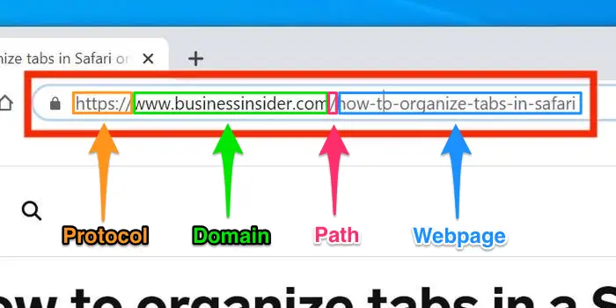
World Wide Web
How It Works?
When you enter a URL (Uniform Resource Locator) into a web browser, the browser sends a request to the web server hosting the page.
The server responds by sending the requested HTML document back to the browser, which then displays it to the user.
Load additional resources like CSS and JavaScript.
Notes:
How It Works:
When you enter a URL (Uniform Resource Locator) into a web browser, the browser sends a request to the web server hosting the page. The server responds by sending the requested HTML document back to the browser, which then displays it to the user.
The browser can also load additional resources like CSS (Cascading Style Sheets) for styling and JavaScript for interactivity, enhancing the user experience.
Impact:
The World Wide Web has revolutionized communication, commerce, education, and entertainment. It has enabled the rise of social media, e-commerce platforms, online learning, and countless other digital services.
It has democratized access to information, allowing people from all over the world to publish content and share knowledge.

Slide 9
World Wide Web
Evolution
Evolved from its early days of static HTML pages to a dynamic and interactive platform. Technologies like CSS, JavaScript, and various web frameworks have transformed the web into a highly interactive medium.
Web 2.0 introduced user-generated content, social networking, and collaboration, further enhancing the web’s role in our daily lives.
Future
Web 3.0, which aims to create a more decentralized, secure, and user-centric web. Innovations like the Semantic Web and blockchain technology are also shaping the future of the web.
Notes:
Evolution:
The web has evolved from its early days of static HTML pages to a dynamic and interactive platform. Technologies like CSS, JavaScript, and various web frameworks have transformed the web into a highly interactive medium.
The advent of Web 2.0 introduced user-generated content, social networking, and collaboration, further enhancing the web’s role in our daily lives.
Future:
The web continues to evolve with the development of new technologies like Web 3.0, which aims to create a more decentralized, secure, and user-centric web. Innovations like the Semantic Web and blockchain technology are also shaping the future of the web.

Slide 10
Web Communication
HTTP (HyperText Transfer Protocol)
Standard protocol used for transferring web pages and other content from a web server to a web browser. It operates over TCP (Transmission Control Protocol) and is responsible for transmitting data in plain text, meaning the data can be intercepted and read by anyone who manages to access it.
HTTPS (HyperText Transfer Protocol Secure)
An extension of HTTP that includes security features. It uses SSL/TLS (Secure Sockets Layer/Transport Layer Security) protocols to encrypt the data being transmitted, ensuring that even if the data is intercepted, it cannot be read without decryption.
Notes:
HTTP (HyperText Transfer Protocol) and HTTPS (HyperText Transfer Protocol Secure) are protocols used for transmitting data between a web browser and a web server. While they serve the same basic purpose, there are crucial differences between them that have significant implications for security and privacy.
HTTP: HTTP is the standard protocol used for transferring web pages and other content from a web server to a web browser. It operates over TCP (Transmission Control Protocol) and is responsible for transmitting data in plain text, meaning the data can be intercepted and read by anyone who manages to access it.
HTTPS: HTTPS is an extension of HTTP that includes security features. It uses SSL/TLS (Secure Sockets Layer/Transport Layer Security) protocols to encrypt the data being transmitted, ensuring that even if the data is intercepted, it cannot be read without decryption.

Slide 11
Web Communication
Key Differences
Security
Port Numbers (80 vs 403)
SSL/TLS Certificates
HTTP, not needed
HTTPS, mandatory
Data Integrity
SEO Impact
Browser Indicators
Notes:
Security:
HTTP: Data transmitted using HTTP is unencrypted, meaning it is vulnerable to interception by hackers or malicious entities. This lack of encryption can lead to data breaches, especially when sensitive information like passwords or credit card details are involved.
HTTPS: Data transmitted using HTTPS is encrypted, making it secure against interception. The encryption process ensures that even if data is intercepted, it cannot be easily deciphered. HTTPS also authenticates the website, ensuring that the communication is with the intended server.
Port Numbers:
HTTP: Typically operates over port 80.
HTTPS: Operates over port 443, which is dedicated to encrypted communications.
SSL/TLS Certificates:
HTTP: Does not require an SSL/TLS certificate. As a result, there’s no encryption and no guarantee that the server is who it claims to be.
HTTPS: Requires an SSL/TLS certificate issued by a trusted Certificate Authority (CA). This certificate verifies the identity of the server and enables the encryption of data, adding a layer of trust and security.
Data Integrity:
HTTP: Data can be altered or corrupted during transmission without detection, as there are no integrity checks in place.
HTTPS: Ensures data integrity by detecting if any data has been tampered with during transmission, thus preventing man-in-the-middle attacks.
SEO Impact:
HTTP: Websites using HTTP may be penalized by search engines like Google, which prioritize secure websites in their rankings.
HTTPS: HTTPS is favored by search engines, leading to better search engine optimization (SEO) rankings. This means that secure websites are more likely to appear higher in search results.
Browser Indicators:
HTTP: Browsers typically display an "insecure" warning or a "not secure" message next to the URL of a website using HTTP, alerting users to potential risks.
HTTPS: Browsers display a padlock icon or “secure” message, indicating that the connection is encrypted and the website is trustworthy.

Slide 12
Web Communication
Importance of HTTPS for Web Communication
Privacy and Security, protecting user data, especially on websites that handle sensitive information like personal details, passwords, or payment information.
Trust and Credibility, perceived as more trustworthy by users.
Compliance and Legal Requirements, regulations and data protection laws, such as the General Data Protection Regulation (GDPR) in Europe, require that websites use HTTPS to protect user data.
Protection Against Cyber Threats, HTTPS protects against various cyber threats, including man-in-the-middle attacks, eavesdropping, and data tampering.
SEO and User Experience, search engines favor HTTPS websites, which can lead to better visibility and higher traffic.
Notes:
Privacy and Security:
HTTPS is crucial for protecting user data, especially on websites that handle sensitive information like personal details, passwords, or payment information. It prevents attackers from intercepting and misusing data, ensuring that users’ privacy is maintained.
Trust and Credibility:
Websites using HTTPS are perceived as more trustworthy by users. The presence of an SSL/TLS certificate and a secure connection indicates that the website takes security seriously, which can enhance the credibility of the site.
Compliance and Legal
Requirements:
Many regulations and data protection laws, such as the General Data Protection Regulation (GDPR) in Europe, require that websites use HTTPS to protect user data. Failure to implement HTTPS can lead to legal consequences and loss of user trust.
Protection Against Cyber Threats:
HTTPS protects against various cyber threats, including man-in-the-middle attacks, eavesdropping, and data tampering. By ensuring that the data is encrypted, HTTPS makes it much more difficult for attackers to access or alter the information being transmitted.
SEO and User Experience:
As mentioned earlier, search engines favor HTTPS websites, which can lead to better visibility and higher traffic. Additionally, users are more likely to stay on and interact with a website they perceive as secure, improving the overall user experience.

Slide 13
Web Communication
How the Client-Server Model Facilitates Communication Over the Web ?
Client-Server model is a fundamental architecture that underpins how communication occurs over the web. The client is the entity that initiates communication. While the server is the entity that responds to the client's requests.
The communication begins when the client sends a request to the server. This request is usually made through the HTTP or HTTPS protocol, which standardizes the way data is transmitted over the web.
Notes:
1. Client and Server Roles:
The Client:
The client is the entity that initiates communication. It could be a web browser, a mobile app, or any other software that requests information or services from a server. The client's primary role is to send requests to the server and process the responses.
The Server:
The server is the entity that responds to the client's requests. It is typically a more powerful machine or a set of machines that store data, host websites, or run applications. The server's role is to process incoming requests, retrieve the necessary data or perform required operations, and send back a response to the client.
2. The Request-Response Cycle:
Request:
The communication begins when the client sends a request to the server. This request is usually made through the HTTP or HTTPS protocol, which standardizes the way data is transmitted over the web. The request might ask for a web page, a file, or some data from a database.
Processing:
Once the server receives the request, it processes it by retrieving the required resources, executing server-side scripts, or interacting with databases. The server determines what response to send back to the client.
Response:
After processing the request, the server sends back a response. This response typically includes the requested content (like an HTML page), status codes (like 200 OK or 404 Not Found), and other necessary metadata. The client then renders this content for the user.
3. Example of Web Communication:
Web Page Load:
When you enter a URL in a web browser, the browser (client) sends an HTTP/HTTPS request to the web server hosting the website. The server processes this request, gathers the necessary HTML, CSS, JavaScript, and image files, and sends them back to the browser. The browser then interprets and displays these files as a cohesive web page.
4. Scalability and Efficiency:
Handling Multiple Clients:
Servers are designed to handle multiple clients simultaneously. A single server can respond to thousands of clients at once, distributing resources efficiently and ensuring that each client receives a timely response.
Load Balancing:
In more complex systems, load balancing is used to distribute client requests across multiple servers. This ensures that no single server becomes a bottleneck, enhancing the scalability and reliability of web communication.
5. Security Considerations:
Secure Communication:
The use of HTTPS in the client-server model ensures that data transmitted between the client and server is encrypted, protecting it from eavesdropping or tampering. This is crucial for maintaining privacy and security, especially when sensitive information like passwords or financial data is involved.
6. Importance of the Client-Server Model:
Centralized Control:
The client-server model centralizes control over data and services, making it easier to manage, update, and secure. Servers can be maintained and upgraded without requiring changes on the client side, simplifying the overall system management.
Resource Management:
Servers can efficiently manage resources, such as databases and files, and control access to them. This centralization helps in maintaining data integrity and consistency.

Slide 14
Web Communication
How the Client-Server Model Facilitates Communication Over the Web ?
Once the server receives the request, it processes it by retrieving the required resources, executing server-side scripts, or interacting with databases.
After processing the request, the server sends back a response. This response typically includes the requested content (like an HTML page), status codes and other necessary metadata. The client then renders this content for the user.
Notes:
1. Client and Server Roles:
The Client:
The client is the entity that initiates communication. It could be a web browser, a mobile app, or any other software that requests information or services from a server. The client's primary role is to send requests to the server and process the responses.
The Server:
The server is the entity that responds to the client's requests. It is typically a more powerful machine or a set of machines that store data, host websites, or run applications. The server's role is to process incoming requests, retrieve the necessary data or perform required operations, and send back a response to the client.
2. The Request-Response Cycle:
Request:
The communication begins when the client sends a request to the server. This request is usually made through the HTTP or HTTPS protocol, which standardizes the way data is transmitted over the web. The request might ask for a web page, a file, or some data from a database.
Processing:
Once the server receives the request, it processes it by retrieving the required resources, executing server-side scripts, or interacting with databases. The server determines what response to send back to the client.
Response:
After processing the request, the server sends back a response. This response typically includes the requested content (like an HTML page), status codes (like 200 OK or 404 Not Found), and other necessary metadata. The client then renders this content for the user.
3. Example of Web Communication:
Web Page Load:
When you enter a URL in a web browser, the browser (client) sends an HTTP/HTTPS request to the web server hosting the website. The server processes this request, gathers the necessary HTML, CSS, JavaScript, and image files, and sends them back to the browser. The browser then interprets and displays these files as a cohesive web page.
4. Scalability and Efficiency:
Handling Multiple Clients:
Servers are designed to handle multiple clients simultaneously. A single server can respond to thousands of clients at once, distributing resources efficiently and ensuring that each client receives a timely response.
Load Balancing:
In more complex systems, load balancing is used to distribute client requests across multiple servers. This ensures that no single server becomes a bottleneck, enhancing the scalability and reliability of web communication.
5. Security Considerations:
Secure Communication:
The use of HTTPS in the client-server model ensures that data transmitted between the client and server is encrypted, protecting it from eavesdropping or tampering. This is crucial for maintaining privacy and security, especially when sensitive information like passwords or financial data is involved.
6. Importance of the Client-Server Model:
Centralized Control:
The client-server model centralizes control over data and services, making it easier to manage, update, and secure. Servers can be maintained and upgraded without requiring changes on the client side, simplifying the overall system management.
Resource Management:
Servers can efficiently manage resources, such as databases and files, and control access to them. This centralization helps in maintaining data integrity and consistency.

Slide 15
Web Communication
Example of Web Communication
When you enter a URL in a web browser, the browser (client) sends an HTTP/HTTPS request to the web server hosting the website.
The server processes this request, gathers the necessary HTML, CSS, JavaScript, and image files, and sends them back to the browser. The browser then interprets and displays these files as a cohesive web page.

Slide 16
Web Communication
Security Considerations
The use of HTTPS in the client-server model ensures that data transmitted between the client and server is encrypted, protecting it from eavesdropping or tampering. This is crucial for maintaining privacy and security, especially when sensitive information like passwords or financial data is involved.

Slide 17
Web Communication
Why is understanding the HTTP request-response cycle crucial for web developers?
It is the foundation of how web pages load and interact. Every time you visit a website, your browser (the client) sends a request to the server, which then processes that request and sends back the data needed to display the page. Knowing how this works helps developers debug issues, optimize performance, and build better web applications.

Slide 18
Web Communication
Activity: Answer the following questions
Can you think of any situations where secure communication (HTTPS) is absolutely necessary?
What could happen if a website doesn't use HTTPS? How does this affect user trust and data security?

Slide 19


Web Communication
Importance of Web Standards
Web standards, set by organizations like W3C and WHATWG, are necessary because they ensure that websites work consistently across different browsers and devices. These standards help developers create web content that is accessible, reliable, and compatible for everyone, making the web a more unified and user-friendly experience.
Notes:
The Web Hypertext Application Technology Working Group (WHATWG) is a community of people interested in evolving HTML and related technologies.
The World Wide Web Consortium (W3C) is the main international standards organization for the World Wide Web. Founded in 1994 and led by Tim Berners-Lee, the consortium is made up of member organizations that maintain full-time staff working together in the development of standards for the World Wide Web.

Slide 20
Web Communication
Importance of Web Standards
Web standards ensure that web applications look and function the same across different browsers and devices. By following these standards, developers can create websites that are compatible and work smoothly, no matter what browser or device users are using. This consistency makes the web more reliable and user-friendly for everyone.
Accessibility standards, like the Web Content Accessibility Guidelines (WCAG), play a crucial role in web communication by ensuring that websites are usable by everyone, including people with disabilities.

Slide 21
Web Communication
Impact on Developers
Developers use these standards to create content that is accessible to all users, such as adding text descriptions for images or ensuring that websites can be navigated using a keyboard.
Impact on Users
For users, accessibility standards mean that they can interact with and understand web content, regardless of their abilities. This makes the web more inclusive, allowing everyone to access information and services equally.

Slide 22
Web Communication
Tools and Technologies
Development tools like text editors, browsers, and developer tools enhance the web development process by making it easier to write, test, and debug code.
Text Editors, help write and organize code efficiently, with features like syntax highlighting and code suggestions.
Browsers, allows you to see how your websites will look and function in real time, ensuring everything works as expected.
Developer Tools, let developers inspect and debug their code, fix errors, and optimize performance, making the development process faster and more accurate.
Notes:
Tools and Technologies for Effective Web Communication
Development tools like text editors, browsers, and developer tools enhance the web development process by making it easier to write, test, and debug code.
Text Editors: Help developers write and organize their code efficiently, with features like syntax highlighting and code suggestions.
Browsers: Allow developers to see how their websites will look and function in real time, ensuring everything works as expected.
Developer Tools: Built into browsers, these tools let developers inspect and debug their code, fix errors, and optimize performance, making the development process faster and more accurate.
Overall, these tools simplify the process, helping developers build better websites more efficiently.

Slide 23
Web Communication
Principles of Effective Web Communication
Clarity, ensures that information is easy to read and understand, so users can quickly find what they need.
Consistency, means that the design and layout are uniform across the site, helping users feel comfortable and confident as they explore.
Visual Design, uses colors, fonts, and images to make the site attractive and guide users' attention to important information.
Layout, organizes content in a clear and logical way, so users can quickly find what they're looking for.
Navigation, provides menus and links to help users move around the site easily.

Slide 24
Web Communication
Principles of Effective Web Communication
Multimedia, like images and videos, is important in web communication because it makes content more engaging and easier to understand.
They can illustrate concepts, grab attention, and make the content more memorable and interesting.
If not used properly, they can slow down the website, distract from the main message, or cause accessibility issues.
Notes:
Multimedia, like images and videos, is important in web communication because it makes content more engaging and easier to understand.
Enhance the Message: They can illustrate concepts, grab attention, and make the content more memorable and interesting.
Hinder the Message: If not used properly, they can slow down the website, distract from the main message, or cause accessibility issues.
Overall, when used effectively, multimedia improves the user experience by making content more dynamic and engaging.

Slide 25
Establishing Presence on the Web
Definition
Establishing a presence on the web means creating and maintaining a digital footprint through various online platforms. This includes having a website, engaging on social media, and being visible in search engines.
Importance
A strong web presence helps you reach a wider audience, build credibility, and achieve your personal or business goals. It’s essential for visibility, marketing, and engagement in today’s digital world.

Slide 26
Establishing Presence on the Web
Defining Your Goals and Audience
Identifying Objectives:
Personal Branding, build an online identity and showcase your expertise.
Business Growth, increase brand awareness, generate leads, and drive sales.
Networking, connect with industry peers and potential collaborators.
Understand Your Audience
Demographics, identify age, gender, location, and interests.
Behavior, how they search for information, what content they engage with, and their preferred communication channels.

Slide 27
Establishing Presence on the Web
Building a Website
Choosing a Domain Name:
Relevance, reflects your brand or business name.
Simplicity, easy to remember and type.
Avoid Complexity, steer clear of hyphens and unusual spellings.
Web Hosting:
Types of Hosting:
Shared Hosting, affordable, suitable for small sites.
VPS Hosting, more control and resources, ideal for growing sites.
Dedicated Hosting, full server control, for high-traffic sites.
Choosing a Provider, look for reliability, customer support, and performance.
Website Design and Development:
User-Friendly Design, simple, intuitive layout with easy navigation.
Responsive Design, ensures the site works well on both desktops and mobile devices.
Loading Times, optimize images and code to speed up your site

Slide 28
Establishing Presence on the Web
Create Quality Content
Clarity and Conciseness, use simple language and get to the point.
SEO Practices, incorporate keywords naturally, use headings for structure.
Engaging Headlines, craft headlines that attract attention and clearly state the benefit.
Maintaining and Updating Your Presence
Regular Updates:
Content Refresh, regularly update your website and social media profiles with new content.
Design Tweaks, make design adjustments to keep your site current and appealing.
Reviewing and Improving:
Periodic Assessments, evaluate your web presence strategy regularly and make necessary improvements.

Slide 29
WEB Course
Design
Build
Launch
THANK YOU...
Instructor
Duration
Manel Fabillar
SY2024 - 1st Semester

